Slide 1
Car Movement
Register

Slide 2
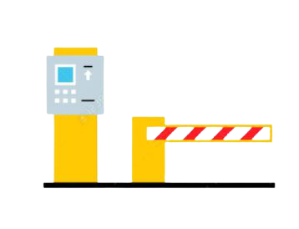
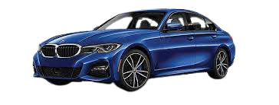
Objective
Maintain vehicles’ in and out records

Slide 3
System maintains Two Types of In and Out Features
Two types of Parking Lots
Residents
Parking Lot of Owner/Tenant
Non - Residents
Parking Lot Reserved for Visitors

Slide 4
Movement Register
Entry
Exit
The System maintains
IN Time
OUT Time
Abnormal Movements

Slide 5
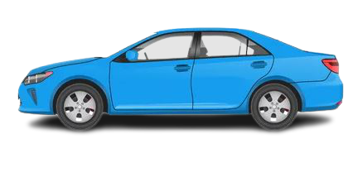
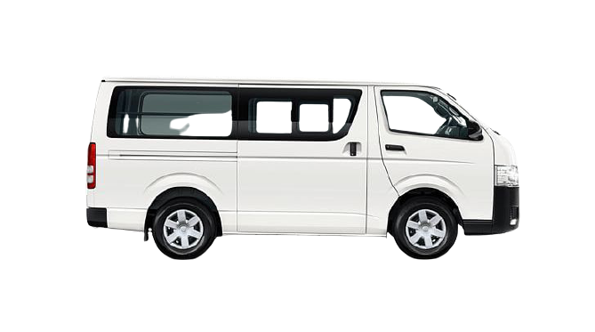
Parking Rate Setup
Provision to rate setup according to vehicle size, like:
Motorcycles
Saloons
Micro Bus
Provision to Rate Setup as per Parking Duration Time
First Hour or less than an hour
First Hour with Successive Next Hour
For A Day
For A Month

Slide 6
Movement Register
In
Out
Token Issue
Token Submit
Bill Issue

Slide 7
Print Bill Sample
Habro Systems Limited
হ্যাব্রো সিস্টেমস লিমিটেড
Car Park
House# 60/B, Gulshan-01,.Dhaka-1212
ENTRY TIME
29/12/2021 9: 25: 14 AM
VEHICLE NO : 19-3424
Ticket No. : 20211229-047
Duration: 1 Hours 16 Minutes
TK. 25.00
Taka Twenty Five Only
ধন্যবাদ আবার আসবেন
Developed & Maintained By
HABRO SYSTEMS LIMITED
Dhaka, Bangladesh

Slide 8
The Software Can Generate Different Types of Reports

Slide 9
Types of Report
Daily Parking Bill Collection Report
Monthly Bill Collection Report
Yearly Bill Collection Report
On Demand Car Movement Register

Slide 10
The System Maintains
Notice Create
Notice Published
Attendance
Draft Meeting Minutes
Confirm Minutes

